Slide 1


Department of Computer Science and Engineering
LOAN PREDICTION SYSTEM
Mrs. M. Divya M.E.,
MUTTHESH M
220701176

Slide 2
Problem Statement and Motivation
Problem Statement
Traditional loan approval processes are manual, time-consuming, and error-prone.
Fixed criteria often overlook creditworthy applicants and may approve high-risk borrowers.
Lack of intelligent systems leads to inconsistencies and increased non-performing assets (NPAs).
Need for an automated, scalable, and data-driven solution that enhances decision accuracy.
Motivation
Accelerate loan processing with real-time predictions.
Reduce human bias and improve fairness using machine learning.
Increase financial inclusion by identifying non-traditional but reliable borrowers.
Empower institutions with predictive insights to minimize default risks.

Slide 3
Existing System
Loan approvals often rely on manual verification and rule-based assessment.
Decisions are typically made by loan officers based on:
Income documents
Credit history
Employment type
Property details
Highly time-consuming and prone to human bias.
Risk of inconsistent approvals across different branches or officers.

Slide 4
Objectives
Automate Loan Approval Decisions
Develop a machine learning model to predict loan approval outcomes based on applicant data.
Enhance Decision Accuracy
Reduce false approvals and rejections by using data-driven prediction techniques.
Utilize Ensemble & Deep Learning Models
Implement advanced algorithms like Random Forest, XGBoost, or Neural Networks for better performance.
Analyze Key Financial Indicators
Identify and evaluate crucial features (e.g., income, credit history, loan amount) that influence approval.
Enable Real-Time Web-Based Predictions
Integrate the trained model into a user-friendly web interface for real-time loan approval forecasting.
Support Continuous Learning
Design the system to be updated with new data to improve predictions over time.

Slide 5
Abstract
In today’s fast-paced financial environment, the automation of loan approval processes has become essential to enhance efficiency, reduce human error, and ensure unbiased decision-making. Traditional methods rely heavily on manual evaluation of financial documents, which can be time-consuming and has inconsistencies. This project presents a data-driven loan prediction system to determine the likelihood of loan approval based on applicant information such as income, credit history, loan amount, and more. The system employs preprocessing steps like missing value treatment, encoding of categorical variables, and feature normalization. Multiple classification algorithms are evaluated, with the Random Forest Classifier demonstrating the best performance in terms of accuracy, precision, and recall. The final model is deployed through a user-friendly web application using Flask, allowing real-time prediction of loan approval status. This approach not only accelerates the decision-making process for financial institutions but also ensures greater transparency and consistency in loan evaluations.

Slide 6
Proposed System
Data is cleaned, encoded, and scaled for optimal model performance.
Implements supervised machine learning to predict loan approval outcomes.
Key Features used : Credit history, Income, loan amount and property area.
Data is cleaned, encoded and scaled for optimal model performance.
Random forest and XGBoost selected for their accuracy and robustness.
Deployed via a user-friendly Flask web app for real time prediction
Reduces manual workload and potential human errors in financial institutions.
Supports fair and automated decision-making to enhance customer experience.

Slide 7
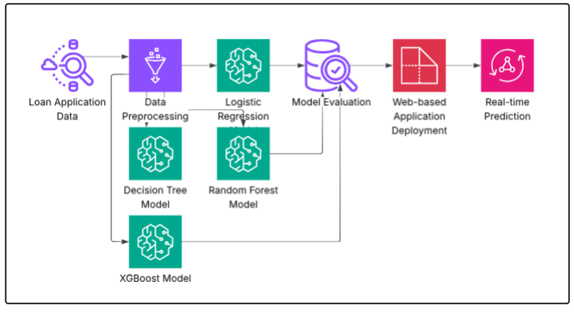
System Architecture

Slide 8
List of Modules
Data Collection Module
Data Preprocessing Module
Feature Engineering Module
Model Training and Evaluation Module
Prediction and Deployment Module

Slide 9
Implementation & Results of Module
Data Handling: Preprocessed 6,000+ loan records, handled missing values, and encoded categorical features.
Model Development: Trained multiple ML models; Random Forest achieved ~84% accuracy with strong precision and recall.
Feature Selection: Chose key predictors like Credit History, Income, and Property Area after EDA.
Deployment: Integrated the best model into a Flask web app for real-time predictions.
Outcome: Developed a fast, scalable, and accurate system for loan approval prediction.

Slide 10
Conclusion & Future Work
Conclusion:
Built an accurate machine learning model for loan approval prediction.
Employed feature engineering and preprocessing for data quality.
Random Forest algorithm offered strong performance and reliability.
Web-based deployment enabled real-time and user-friendly predictions.
Future Scope:
Integrate real-time financial data and credit score APIs.
Implement Explainable AI to justify approval or rejection outcomes.
Enable auto-learning from new application data to improve accuracy.
Extend system to mobile platforms for broader accessibility.

Slide 11
References
[1] A. K. Sharma and P. Goyal, "Loan approval prediction based on machine learning approach," International Journal of Computer Applications, vol. 183, no. 38, pp. 10–14, June 2021.
[2] M. U. Rehman, M. A. Khan, and A. Fatima, "Loan approval prediction using machine learning models," in Proc. 2021 IEEE International Conference on Computer Science and Engineering (ICCSE), Lahore, Pakistan, 2021, pp. 45–50.
[3] P. Patel and R. Shah, "A machine learning approach to predict loan approval," International Research Journal of Engineering and Technology (IRJET), vol. 6, no. 3, pp. 2151–2155, Mar. 2020.
[4] S. Yadav and D. Pal, "Loan prediction using data mining techniques," in Proc. 2019 IEEE Conference on Emerging Technologies in Data Mining and Information Security (IEMIS), Kolkata, India, 2019, pp. 205–209.
[5] V. Singh and K. Gupta, "An effective analysis of loan prediction using machine learning techniques," International Journal of Advanced Research in Computer Science, vol. 10, no. 5, pp. 65–70, Sept.–Oct. 2019.

Slide 12
Thank You

